Slide 1
Job portal
PRESENTED BY : Naveen Singh Manral
27th May 2020

Slide 2
CONTENTS
Introduction
ER Daigram
DB Design Structure
Screen Sort

Slide 3
INTRODUCTION

Slide 4
INTRODUCTION
We have developed the job-portal. This portal can handle data of Recruits (Several Companies) who are looking for suitable candidates for their vacancies.
This portal will be most useful for Consultants for searching of matching job with jobseekers etc.
A registration form is provided through which user can enter details of company like location of company/type of job/status of job/Qualification of jobseekers.

Slide 5
INTRODUCTION(CTD…)
This system can run only on Windows platform.
Supported only in MS-SQL database.
Supportive language is only English.

Slide 6
ER-Diagram

Slide 7
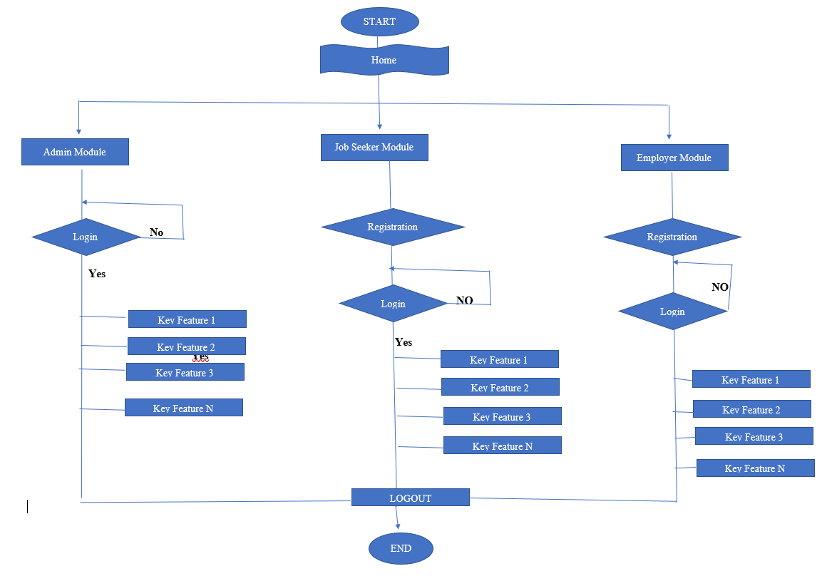

Slide 8
DB Design Structure

Slide 9
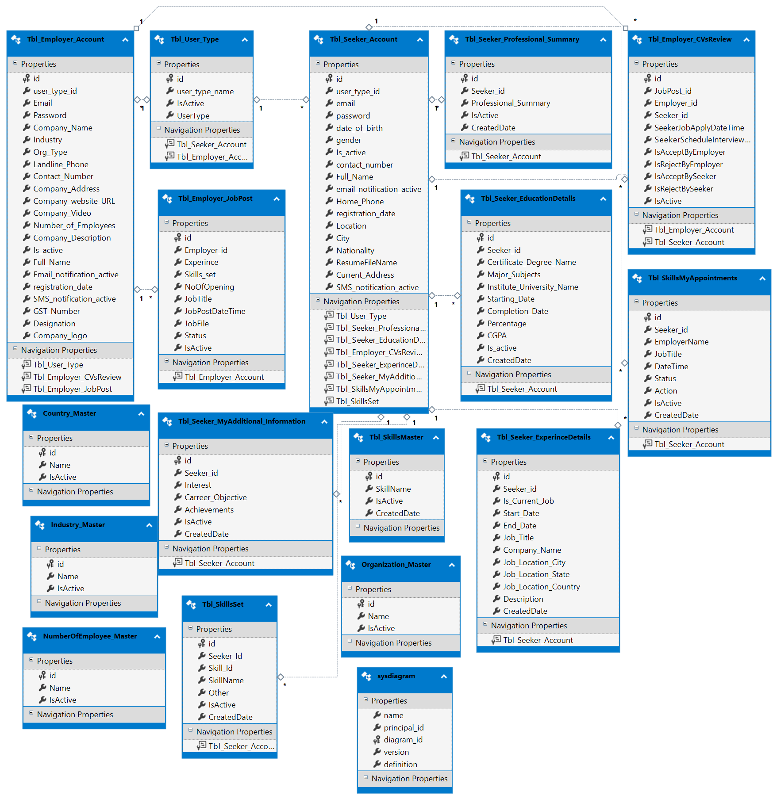

Slide 10
Screen Sort

Slide 11
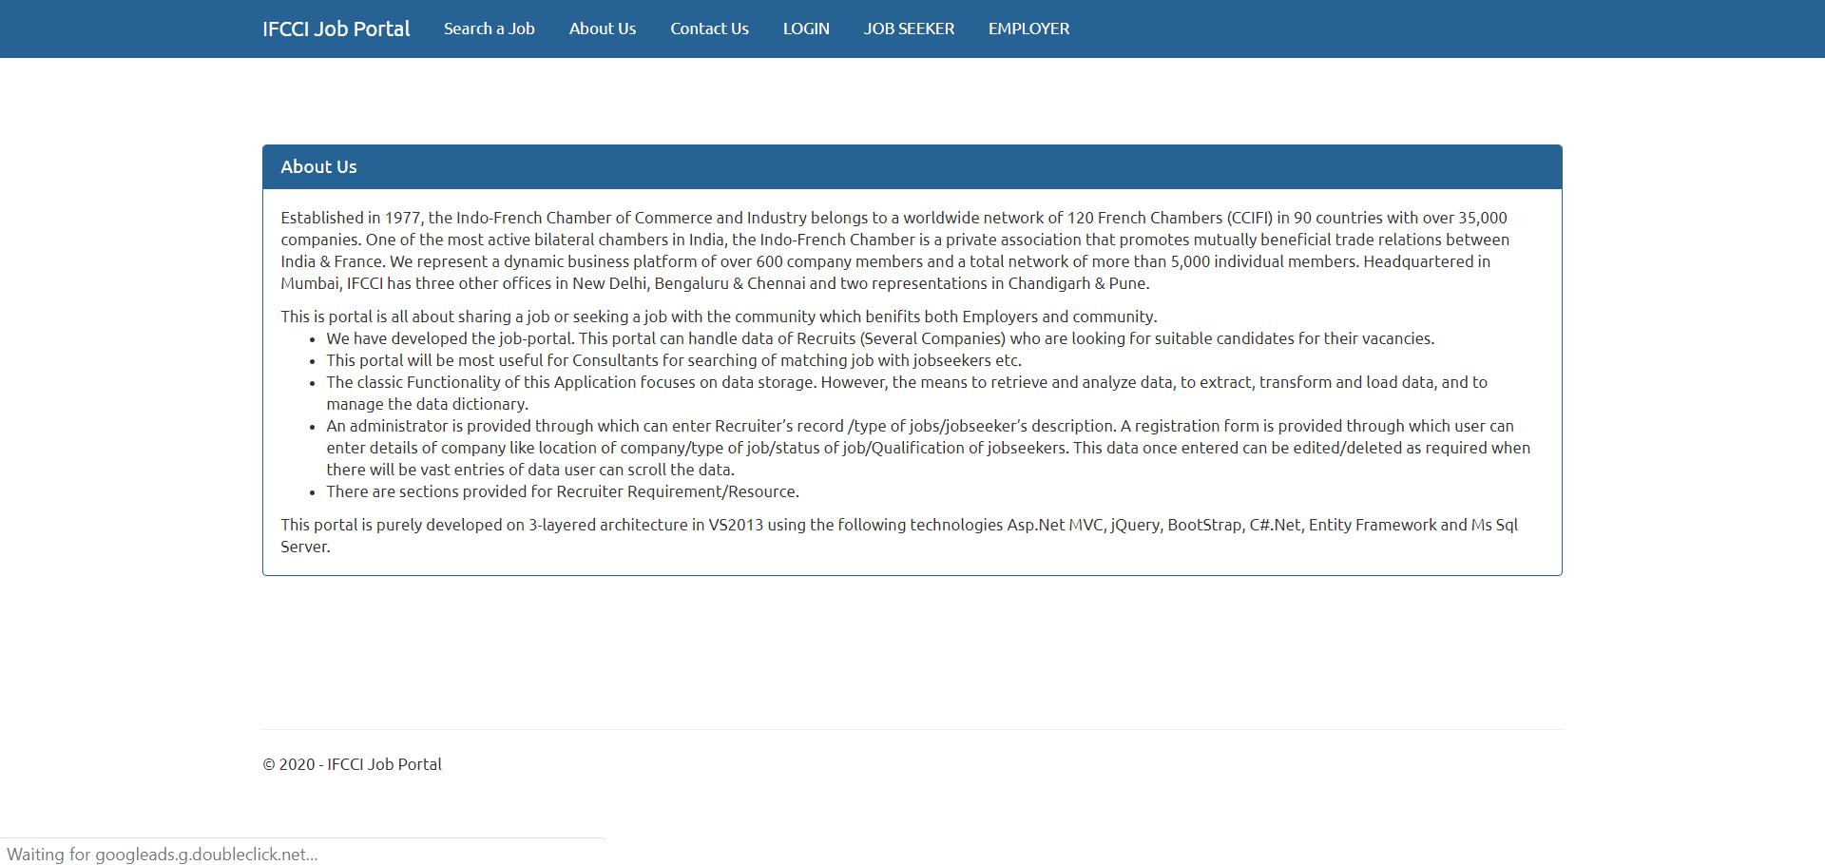

Slide 12
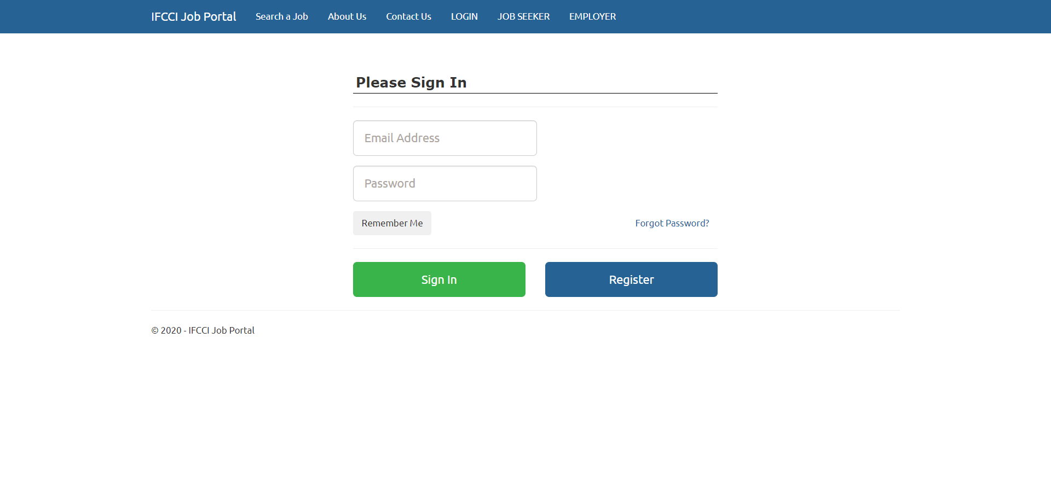

Slide 13
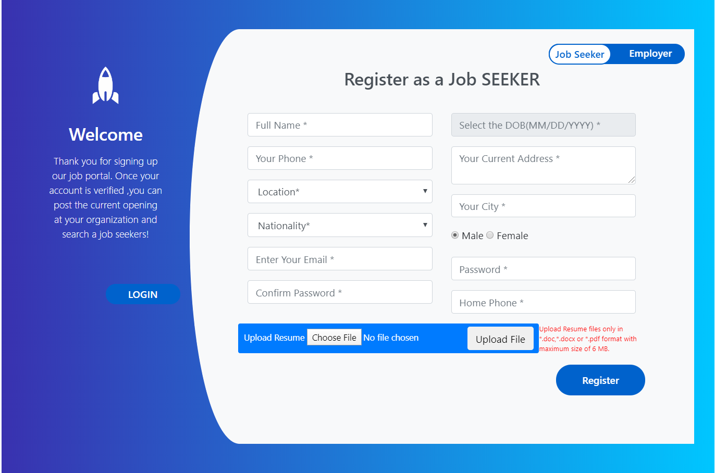

Slide 14
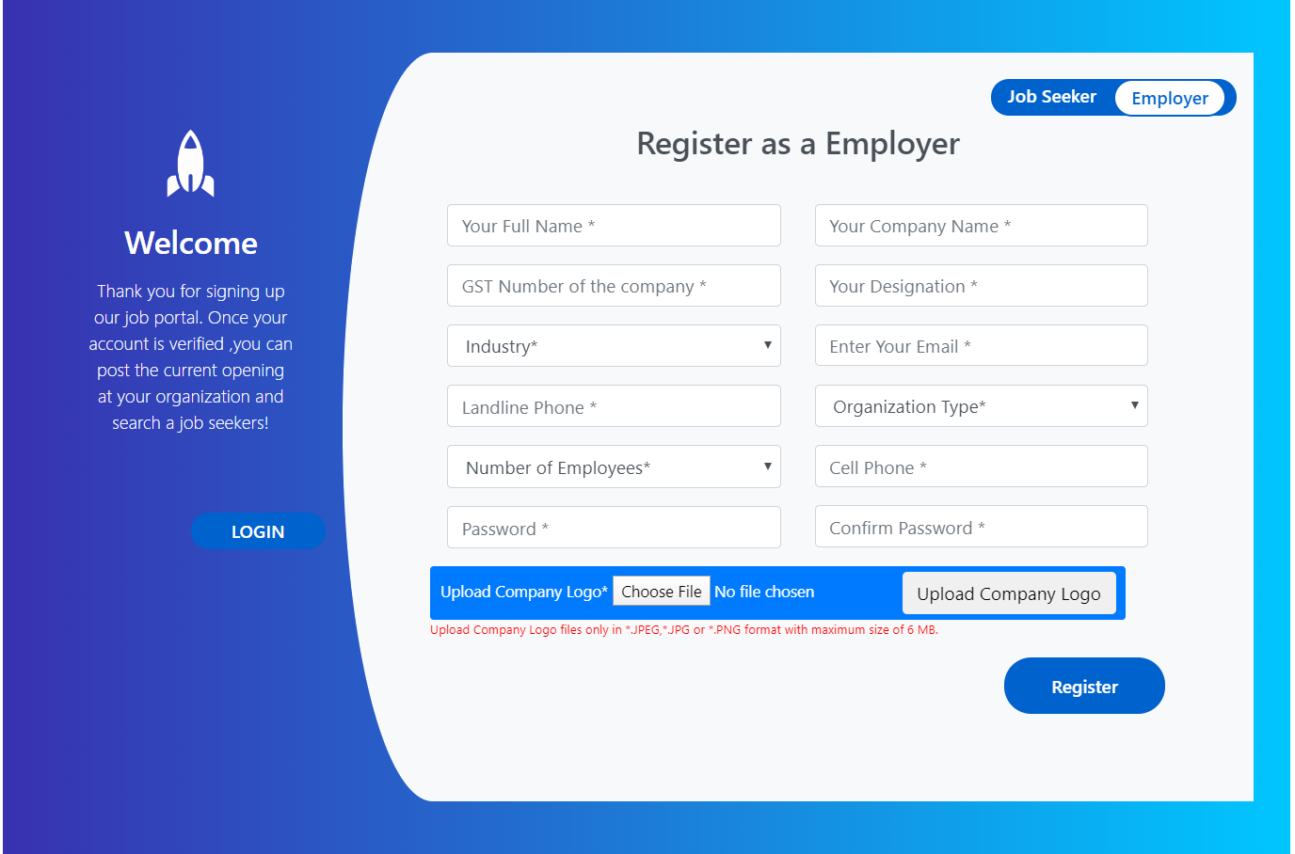

Slide 15
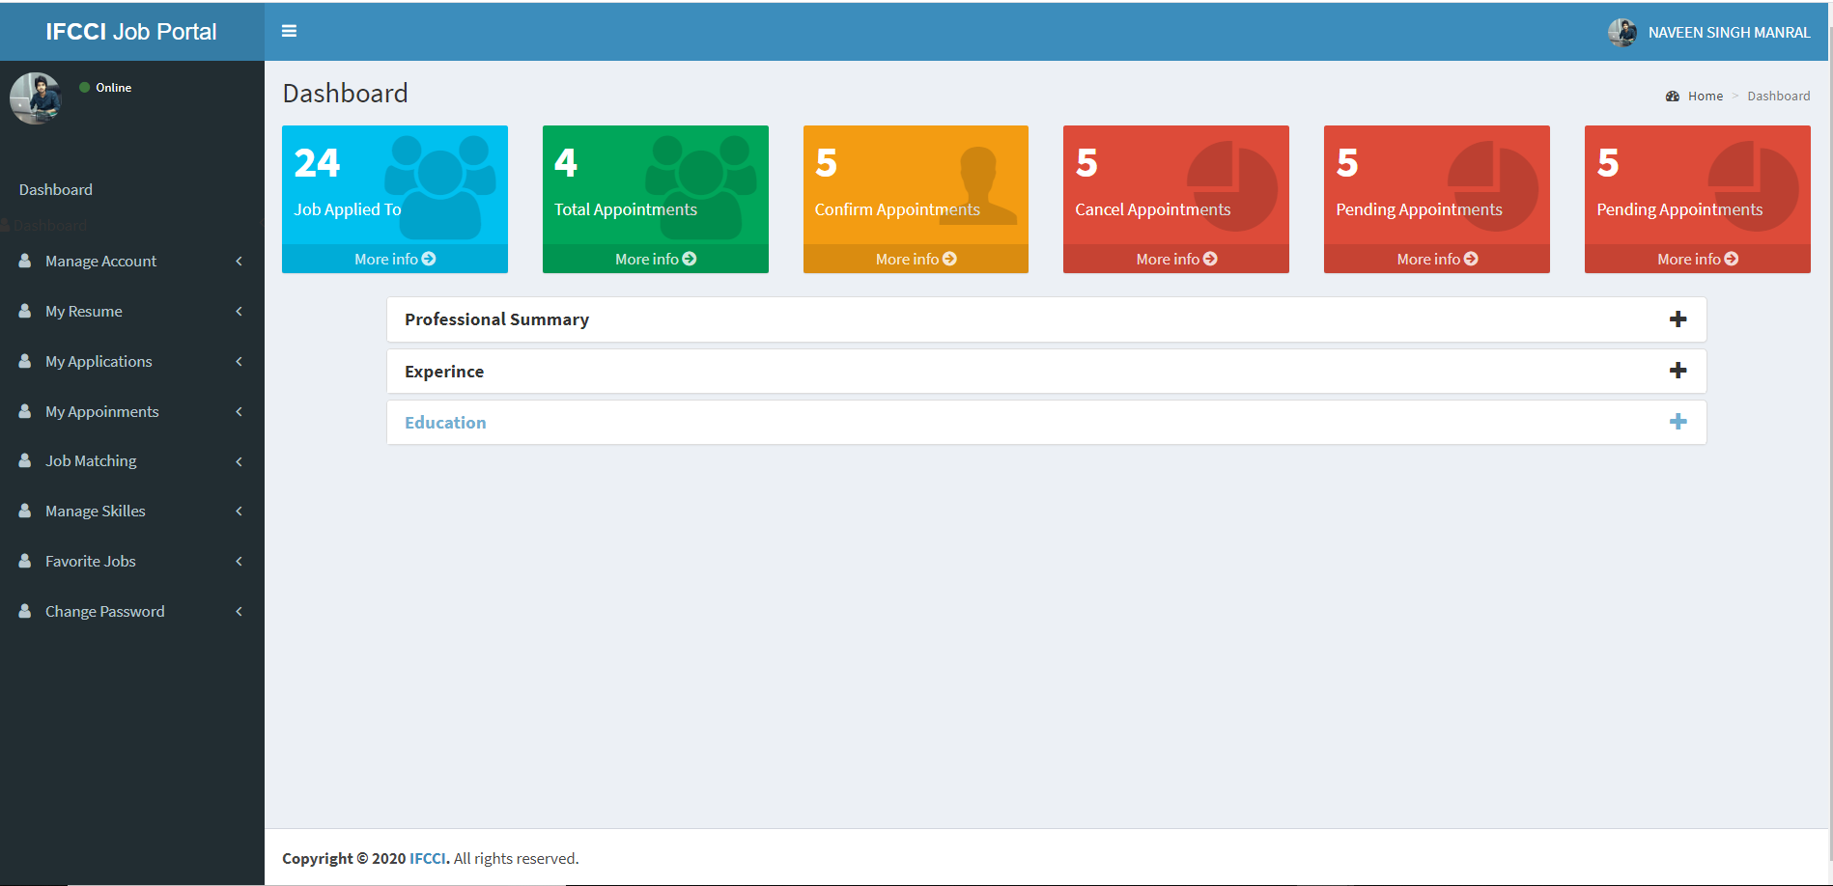

Slide 16
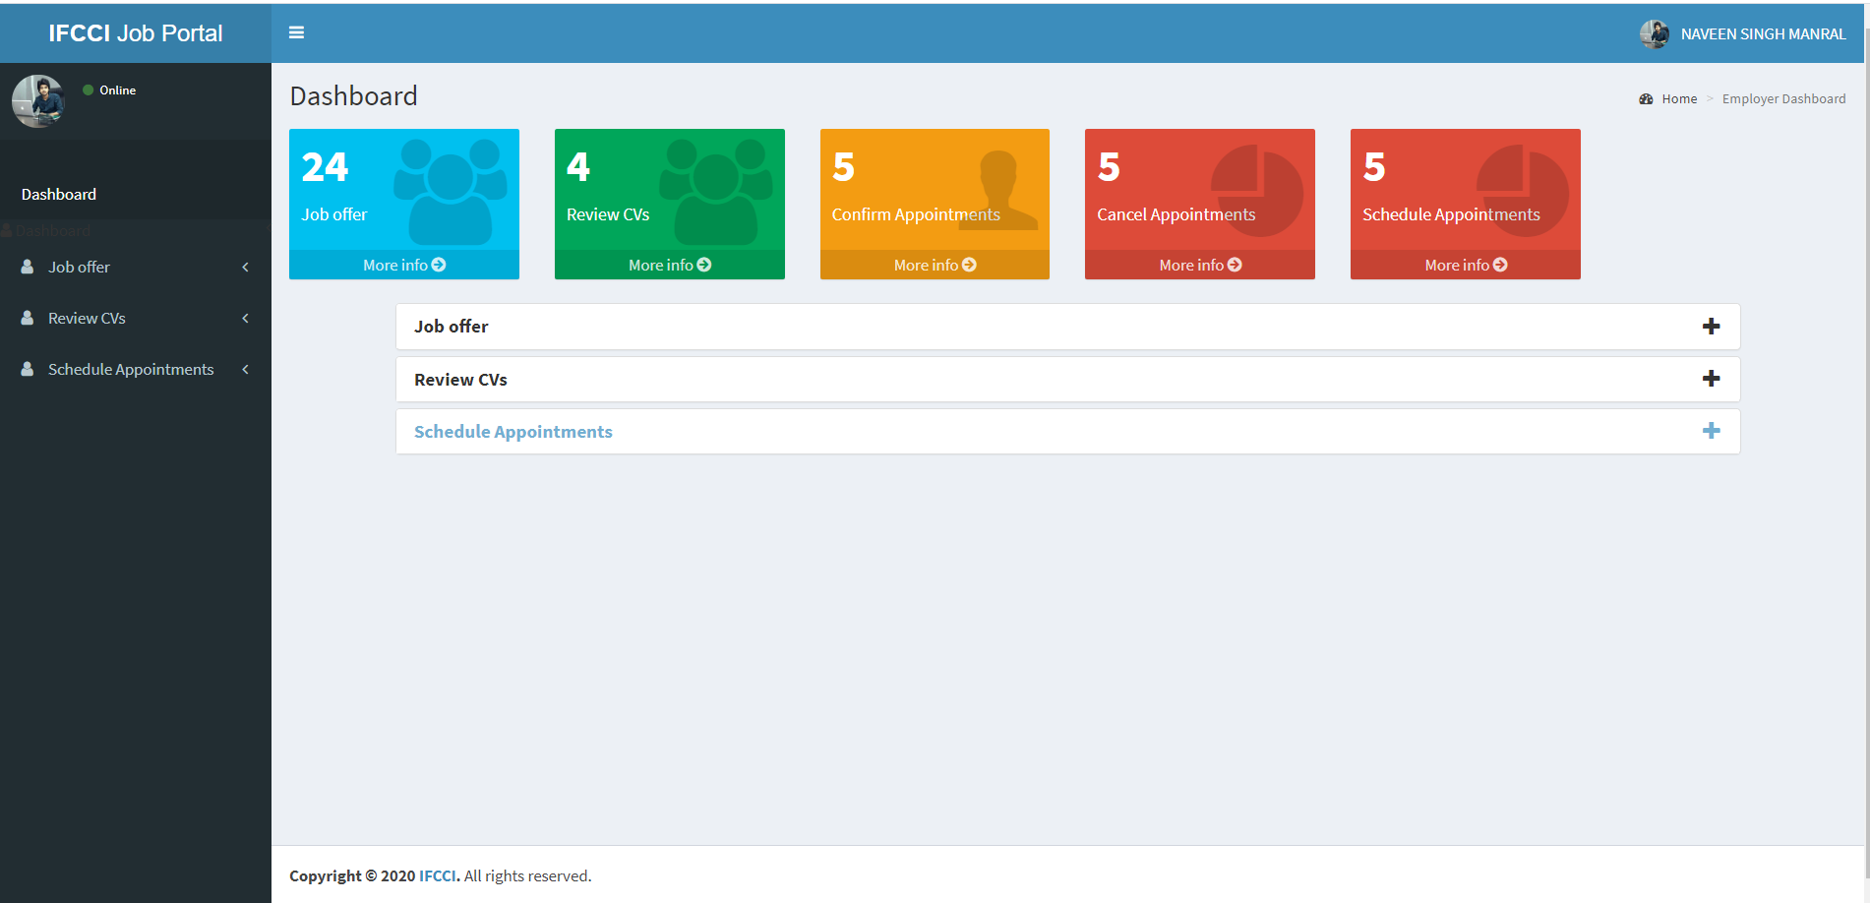

Slide 17
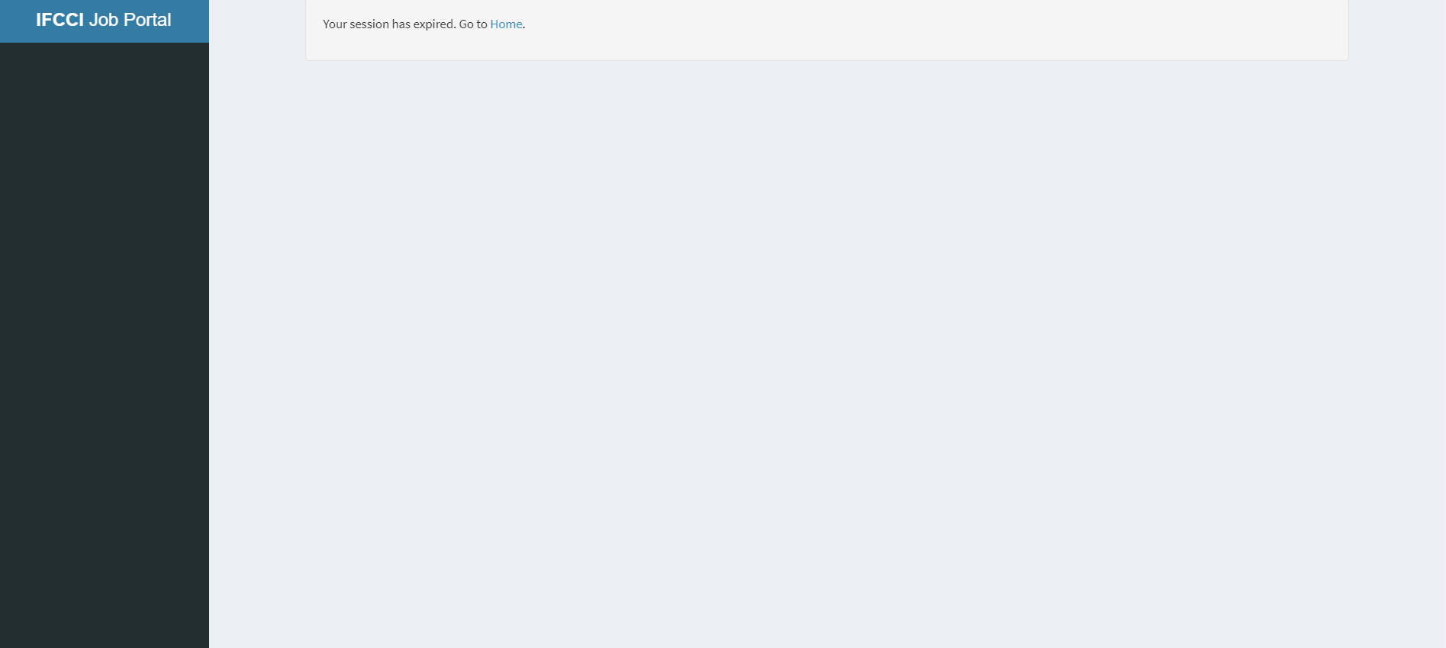

Slide 18
THANK YOU

